Slide 1
Video Compression Optimization using Machine Learning
Second Stage Evaluation
Prepared by:
Alkesh Vaghela – U15CO039
Jay Dudhat – U15CO048
Priyansh Zalavadiya – U15CO050
Apurva Tripathi – U15CO097
Guided by:
Rupa G. Mehta

Slide 2
Key points
Motivation
X265 Encoder
Analysis of static and dynamic background
Proposed framework
Feature extraction system
Future work

Slide 3
Motivation
Rapid development in field of video recording
High quality and large in size
Expertise requires in x265 encoder
Video
Compression
Optimization

Slide 4
X265 Encoder
Motion Estimation(ME)
Motion Compensation(MC)

Slide 5
Analysis

Slide 8
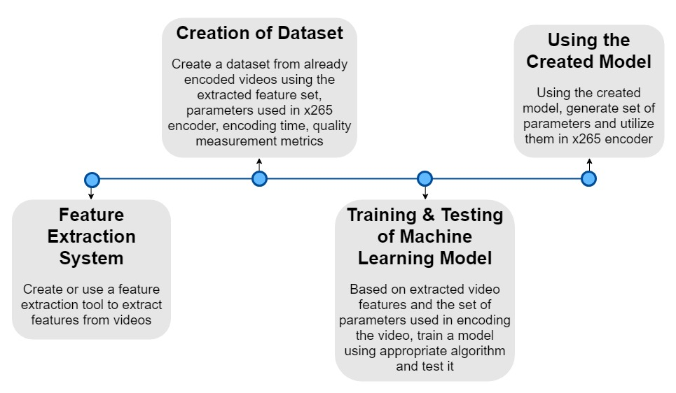
Proposed Framework

Slide 9
Feature Extraction System
Background Subtraction
Pearson Correlation Coefficient
Scene Changes
Intensity Matching

Slide 10
1. Background Subtraction
Creating a statistical representation of the background.
Identifying object motion in foreground by subtracting consecutive frames.

Slide 11
Gaussian Mixture Model

Slide 12
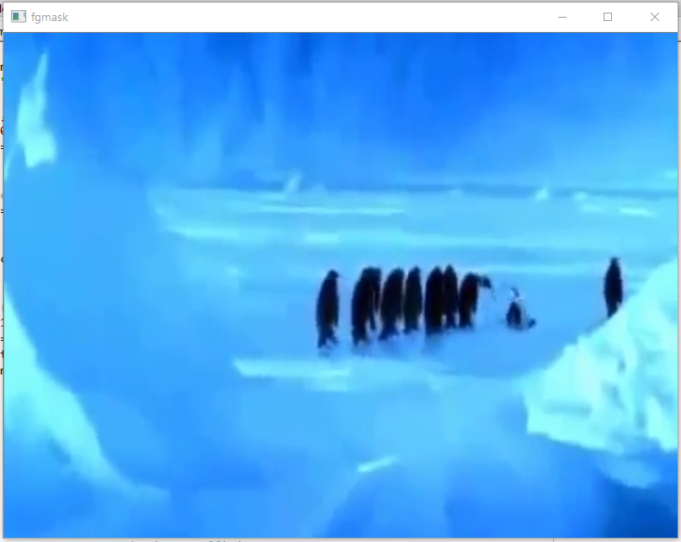
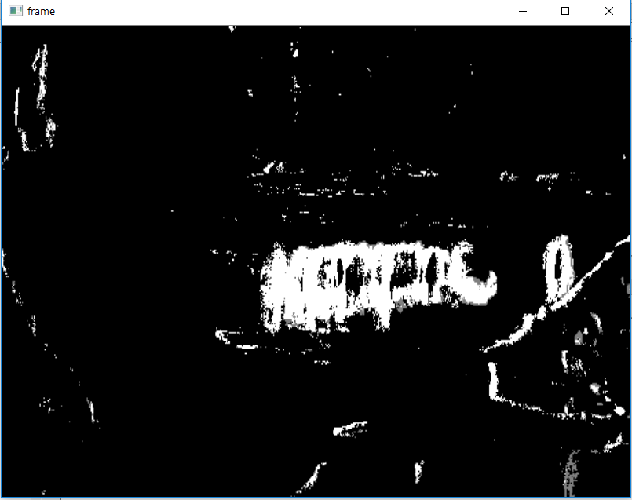
Frame before background substraction
Frame after background substraction

Slide 13
2. Pearson Correlation Coefficient
Correlation between two variable set.
Value between +1 and 1
1 = total positive linear correlation
0 = no linear correlation
-1 = total negative linear correlation
Pearsonr :- inbuilt function

Slide 14

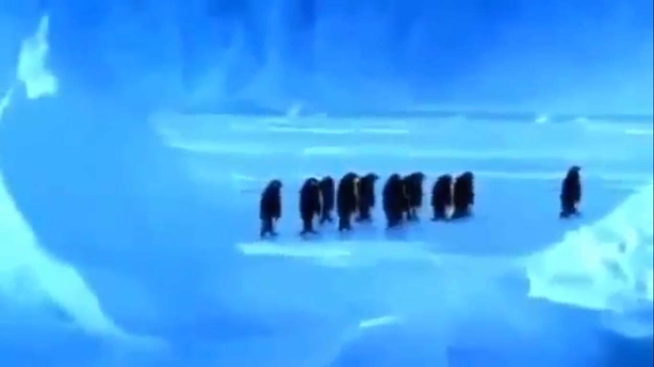
Scene Changes
Entire background changes
Motion feature to reach around 90-100 % for roughly a second

Slide 15
Intensity Matching
Using KNN method of FlannBasedMatcher.
Find similar points on basis of distance between their value.

Slide 16

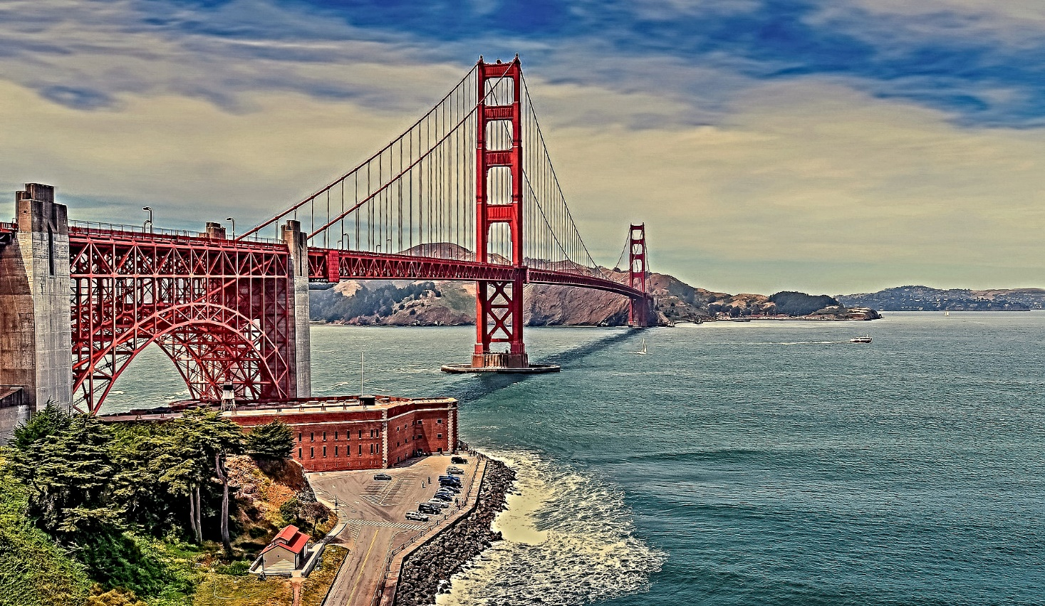
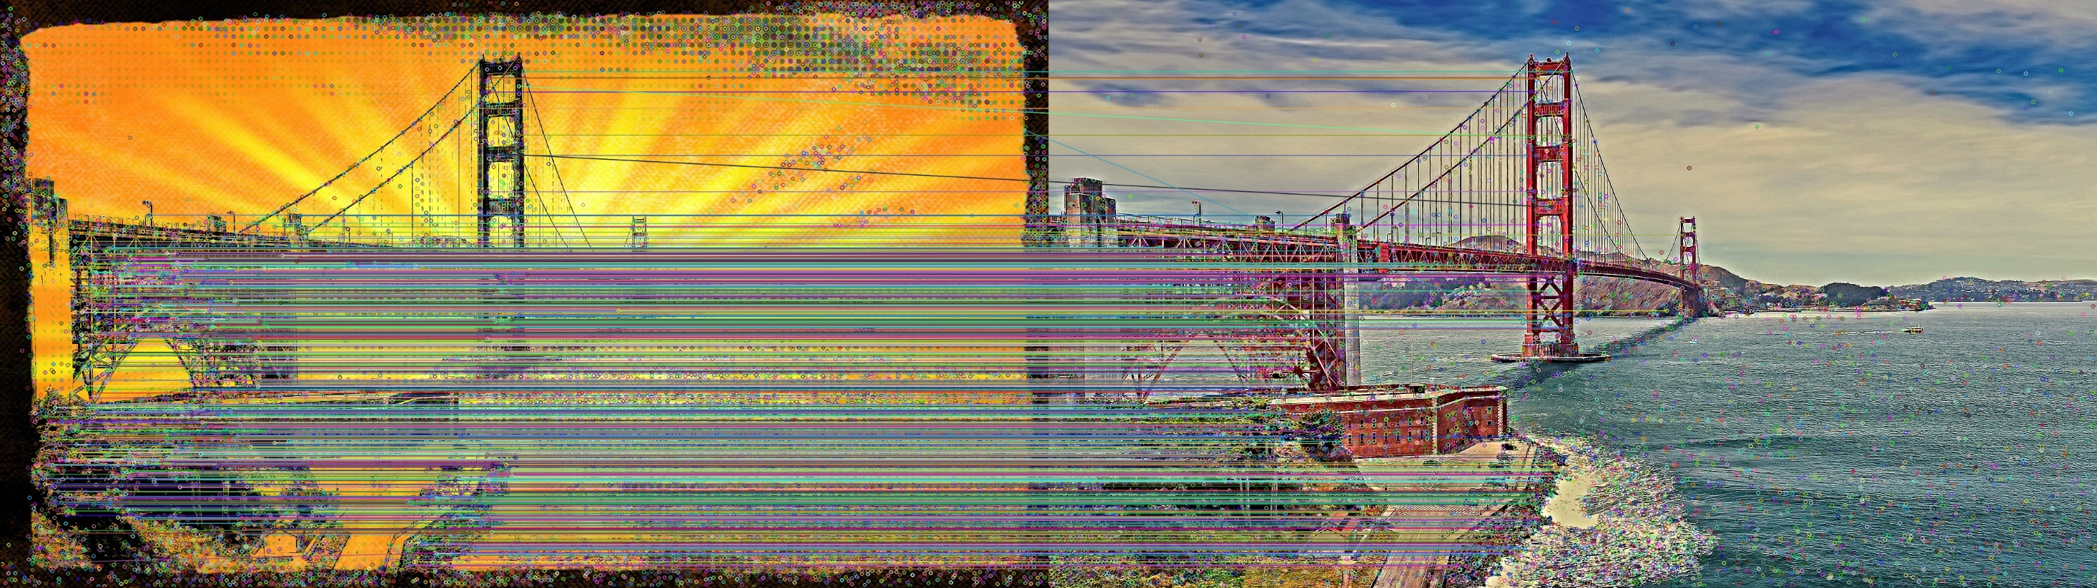

Slide 17
Future Work
Video classification model based on extracted features.
Create optimal datasets to train the model.
By comparing and evaluating optimal machine learning approach for finding optimal parameters of x265 encoder.
Training of machine learning model based on obtained dataset.

